Slide 1


Slide 2
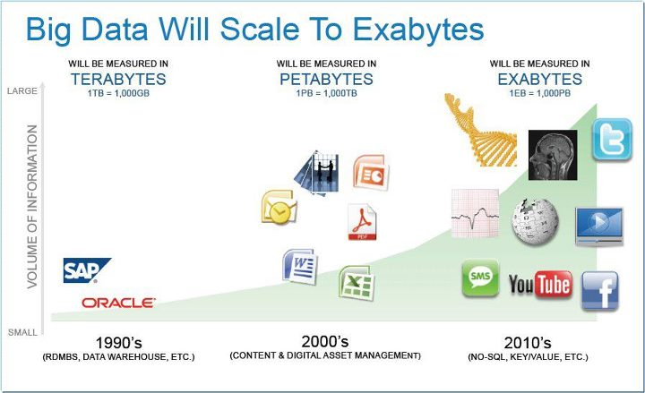

Slide 3
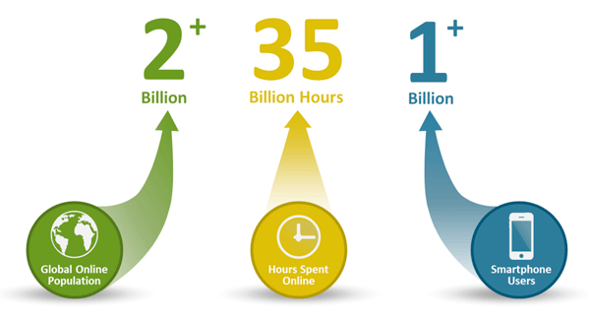
Why BiG Data?
Three trends disrupting the database status quo– Big Data, Big Users, and Cloud Computing
Big Users :Not that long ago, 1,000 daily users of an application was a lot and 10,000 was an extreme case. Today, with the growth in global Internet use, the increased number of hours users spend online, and the growing popularity of smartphones and tablets, it's not uncommon for apps to have millions of users a day.

Slide 4
Why BiG Data?
Big Data :Data is becoming easier to capture and access through third parties such as Facebook, D&B, and others. Personal user information, geo location data, social graphs, user-generated content, machine logging data, and sensor-generated data are just a few examples of the ever-expanding array of data being captured.
Cloud Computing: Today, most new applications (both consumer and business) use a three-tier Internet architecture, run in a public or private cloud, and support large numbers of users.

Slide 5


Slide 6
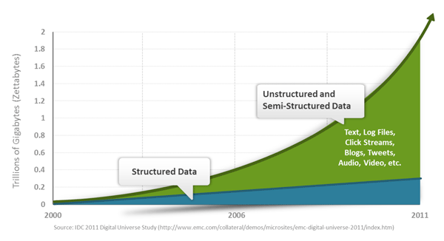

Slide 7
NoSQL
the term means Not Only SQL
It's not SQL and it's not relational
Structured data can be handled by relational database.
NoSQL is designed for unstructured data

Slide 8
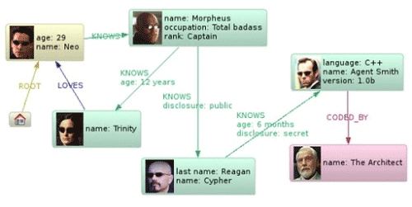
Graph Databases

Slide 9
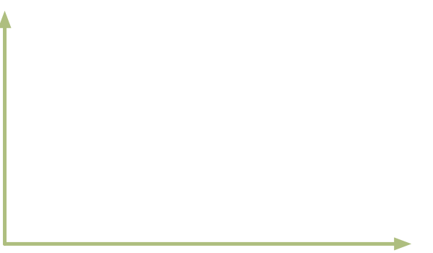



As simple as possible
Memcached
Key / Value
Scalability & Performance
RDBMS
Depth of functionality
Notes:
In memory Key value stores are very fast but not intuitive to map data to and no simple way to query except for Keys
RDBMS deep functionality but not fast plus normalized isn’t for most data types

Slide 10
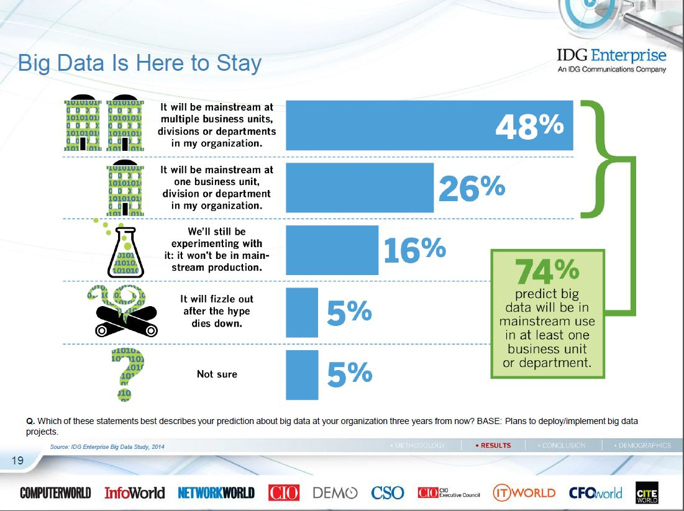

Slide 11
Who uses Big Data?
Amazon/A9
Facebook
Google
New York Times
Veoh
Yahoo!
…. many more

Slide 12
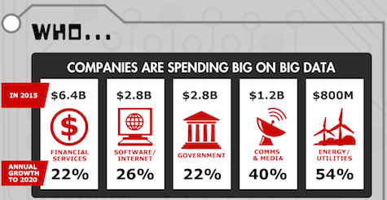

Slide 13

Pig
Started at Yahoo! Research
Now runs about 30% of Yahoo!’s jobs

Slide 14
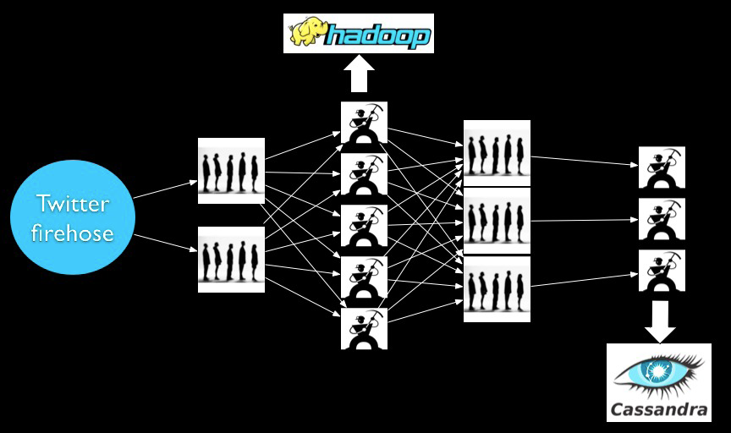
Storm

Slide 15

Apache Sqoop
Apache Sqoop is a tool designed for transferring bulk data between Apache Hadoop and structured datastores such as relational databases or data warehouses

Slide 16
NoSQL Systems: Motivation
Example #1: Web log analysis
Each record: UserID, URL, timestamp, additional-info
Separate records: UserID, name, age, gender, …
Task: Find average age of user accessing given URL

Slide 17
NoSQL Systems: Motivation
Example #2: Social-network graph
Each record: UserID₁, UserID₂
Separate records: UserID, name, age, gender, …
Task: Find all friends of friends of friends of … friends of given user

Slide 18
NoSQL Systems: Motivation
Example #3: Wikipedia pages
Large collection of documents
Combination of structured and unstructured data
Task: Retrieve introductory paragraph of all pages about U.S. presidents before 1900

Slide 19
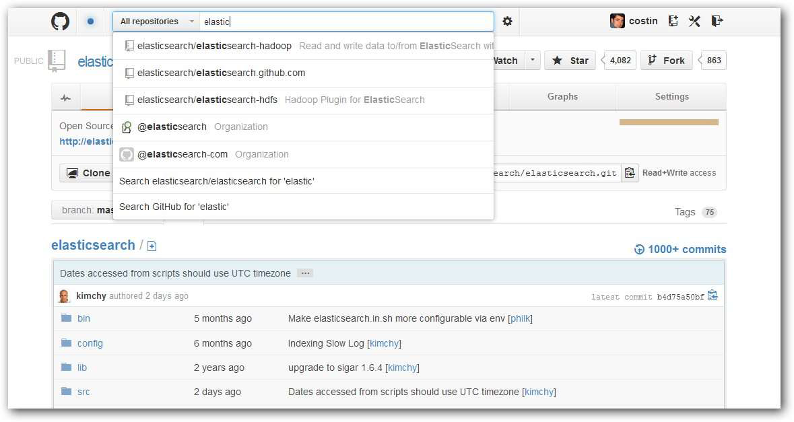
Use - Text Search

Slide 20
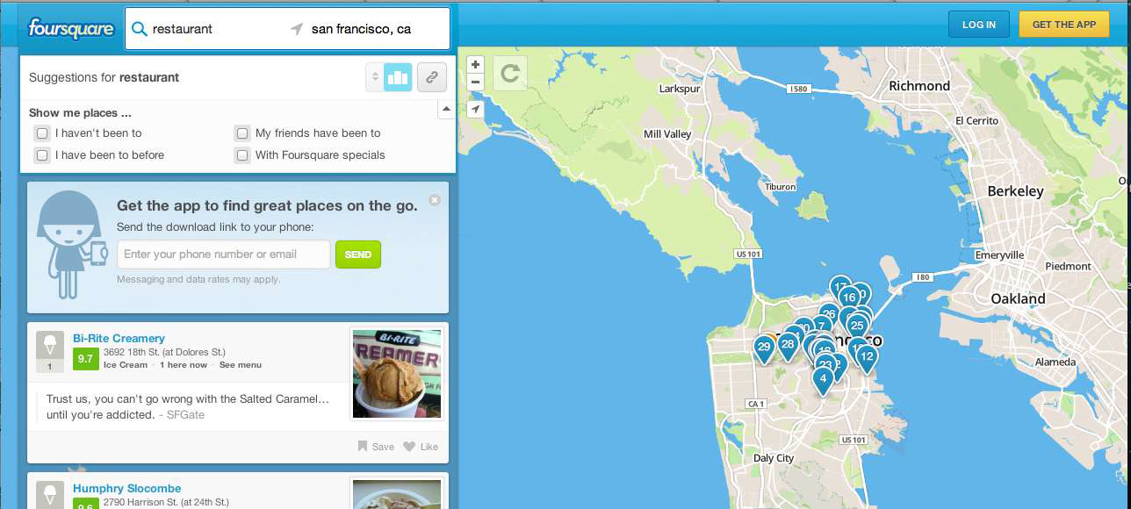
Use - Geolocation
Searches 50,000,000 venues every day

Slide 21
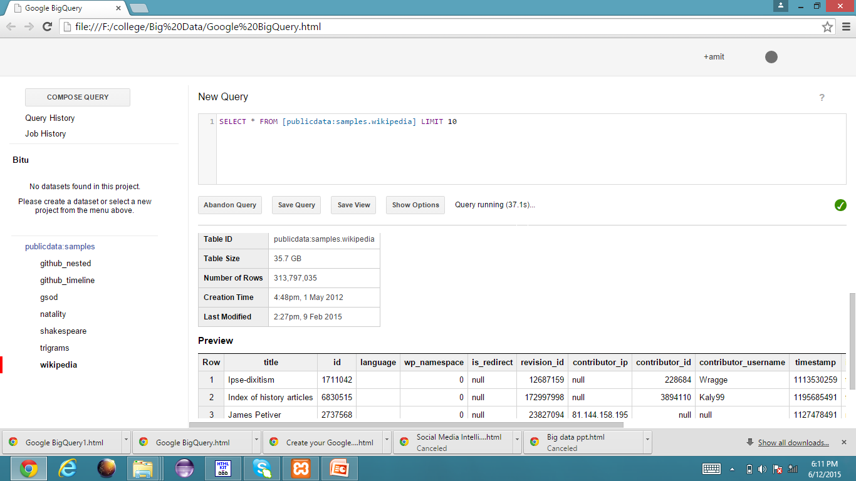

Slide 22
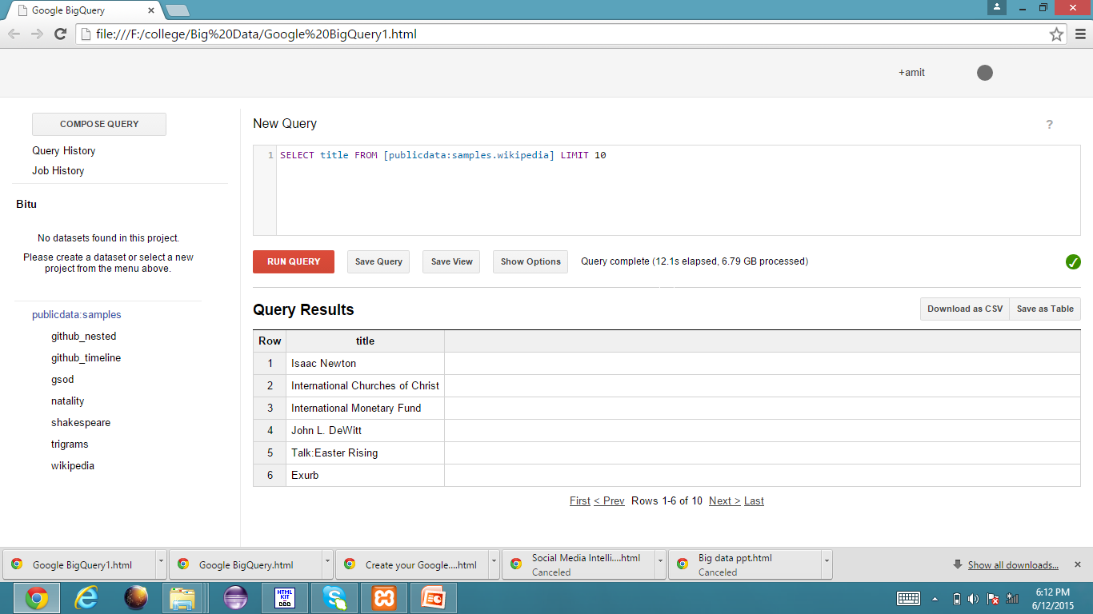

Slide 23
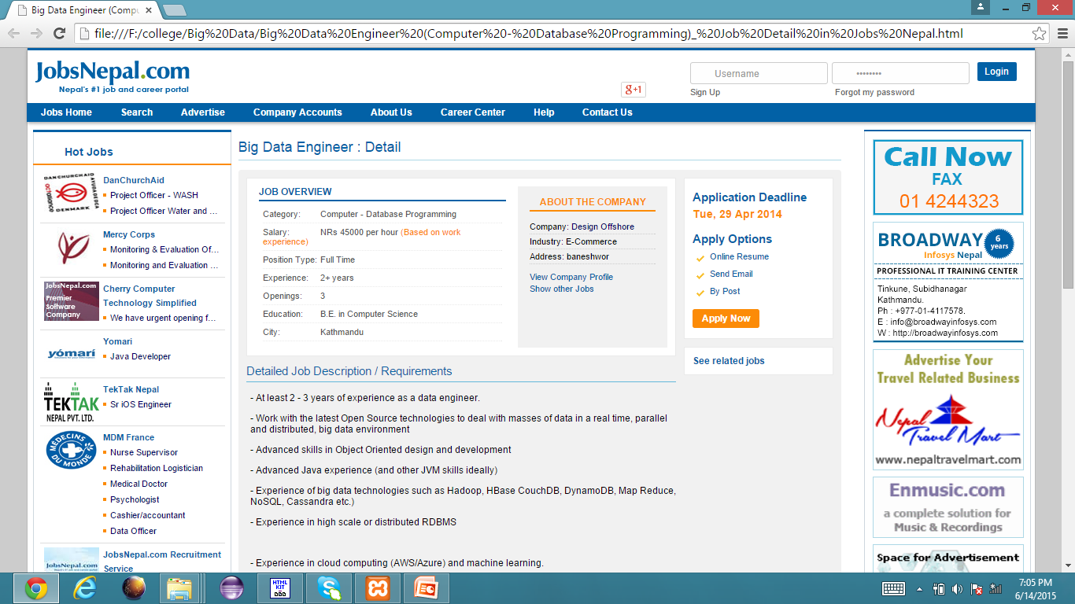

Slide 24
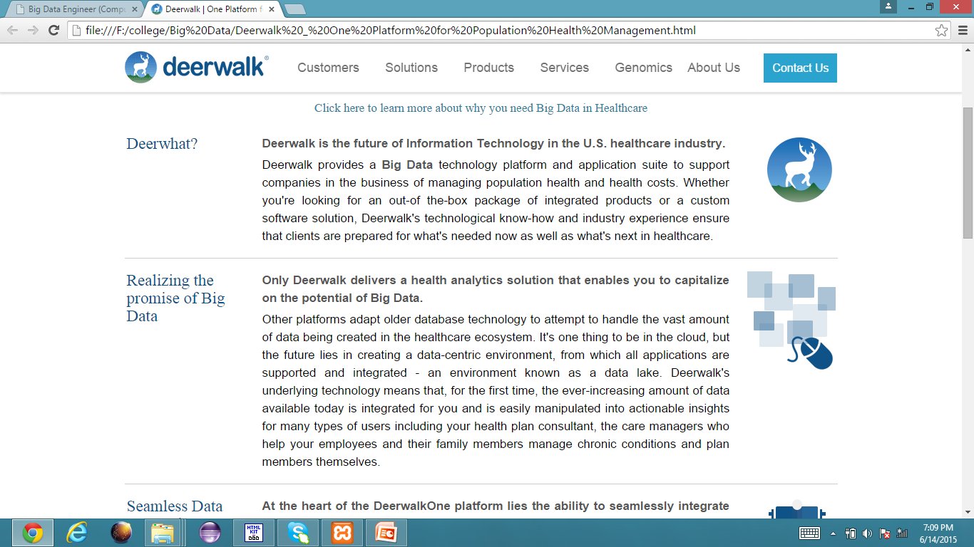

Slide 25
